Slide 1
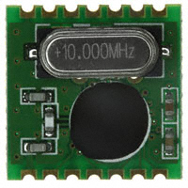
Communication Subsystem
The primary spacecraft will use the radio on Colony-II bus
The radio system for the secondary spacecraft will is being developed here at SLU
Only needs to receive
Consists of an RFID chip and
patch antenna

Slide 2
COM Budget
300 km circular orbit, 5° above horizon
 | Units | Values | Comments & References
Uplink Frequency | MHz | 433 | UHF Uplink
Station TX power | dB | 16.9897
Gain | dBi | 15
Ground Station Losses | dB | 3.6 | Internal Loss on the transmission lines
EIRP | dBW | 28.3897
Pointing Loss | dB | 0.2
Polarization Loss | dB | 0.2
Atmospheric Loss | dB | 2.1
Ionospheric Loss | dB | 0.4
Propagation Range | km | 1500
Path Loss | dB | 148.71
Isotropic Signal @ S/C | dBW | -123.22
G/T | dB-K | -21.17
S/N₀ | dBHz | 84.01
Data Rate, B | dB | 36.02
E_{b}/N₀ | dB | 47.99
Bit Rate Error |  | 0.0000

